Slide 1
Cluster Tracker
Group 4
Ryan Tang Li Yen
Goh Kheng Xi, Jevan
Lock Mei Lin

Slide 2
Aim
To enforce social-distancing rules by identifying and tracking clusters of people – cluster size, inter-cluster distance, and inter-cluster interactions – through sensor fusion.
Introduction
Mechanical Assembly
Depth Camera
Electronics Assembly
BOM
mmWave Sensor
Sensor Comparison

Slide 3
Content
Roles and Responsibilities
Aim and Previous Ideas
Mechanical and Electronics Assemblies
BOM
mmWave Sensor
Depth Camera
Sensor Comparison
Introduction
Mechanical Assembly
Depth camera
Electronics Assembly
BOM
mmWave sensor
Sensor comparison

Slide 4
Roles and Responsibilities
Ryan Tang : Jetson Nano, mechanical and electronic assemblies
Jevan Goh : mmWave sensor, machine learning algorithms
Mei Lin : 3D camera, machine learning algorithms
# | Tasks | 7 | 8 | 9 | 10 | 11 | 12
1 | Pan mechanism for L515
2 | Data output from L515 and IWR6843
3 | Cluster-size (number of people) using L515
4 | Communication between sensors and servo motor
5 | Inter-cluster distance using L515 and IWR6843
6 | Inter-cluster interaction using L515
Introduction
Mechanical Assembly
Depth Camera
Electronics Assembly
BOM
mmWave Sensor
Sensor Comparison

Slide 5
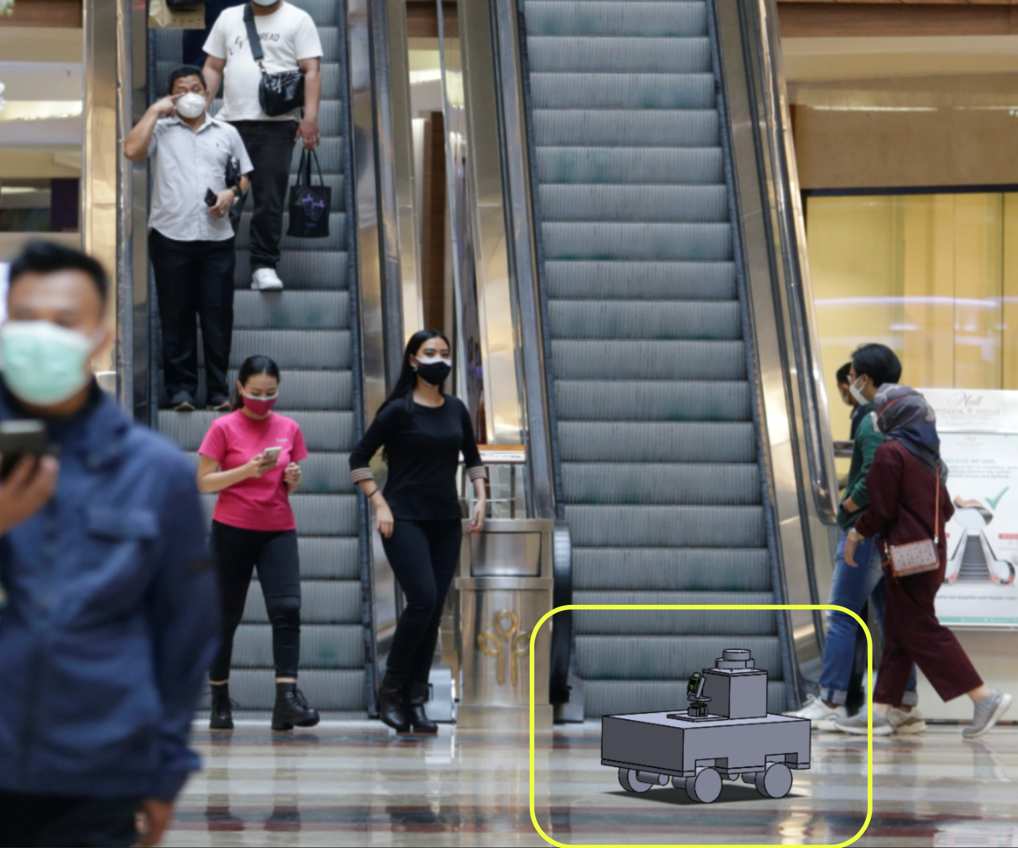
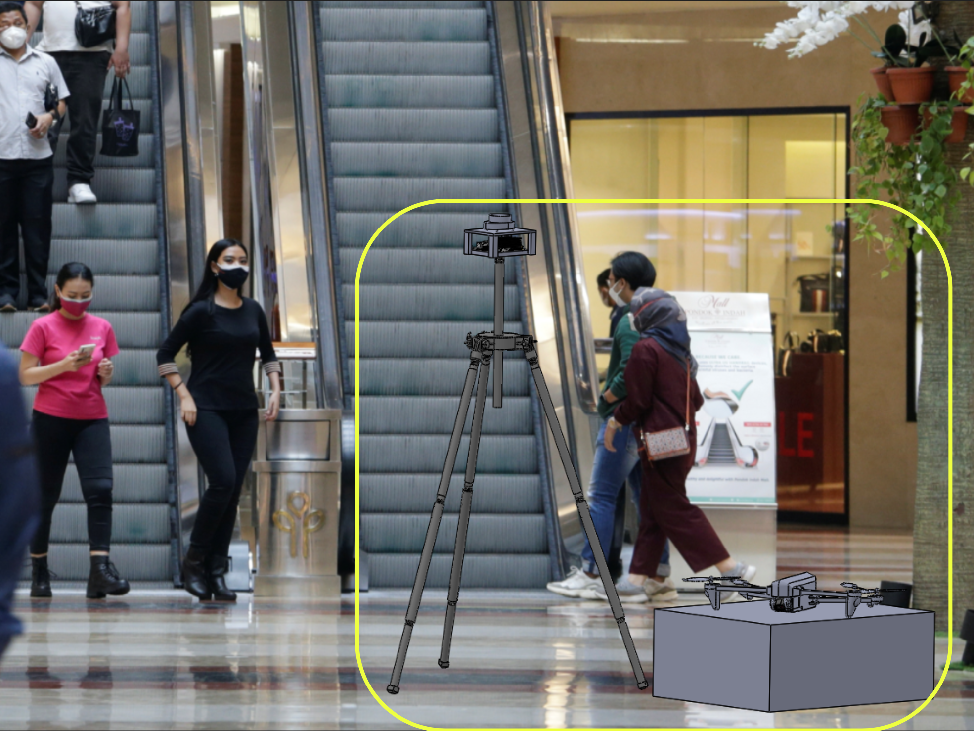
Previous Ideas
Robot Car: 2D LiDAR + Camera
Drone: 2D LiDAR on tripod
Limited FOV
Highly prone to obstructions
Limited FOV
Only x-z data
No indoor navigation system for drone
Introduction
Mechanical Assembly
Depth Camera
Electronics Assembly
BOM
mmWave Sensor
Sensor Comparison

Slide 6
Mechanical Assembly
NVIDIA Jetson Nano
and PCA9685 Servo Control Board
Processes and integrates data from sensors and controls L515 servo
Intel RealSense L515 Depth Camera
Image data for people recognition; IR data for distance measurement
Alzo Suspended Drop Ceiling Camera Mount
Clamps onto drop ceiling beam. Modified with our sensor mounts
MG995 Servo Motor
Pans L515 over 120º
Texas Instrument IWR6843AOPEVM
mmWave sensor
Radar data for object tracking and distance measurements
Servo Mount
Mounts servo with clamp and friction
Scanning Area: 10 m x 10 m
Introduction
Mechanical Assembly
Depth Camera
Electronics Assembly
BOM
mmWave Sensor
Sensor Comparison

Slide 7
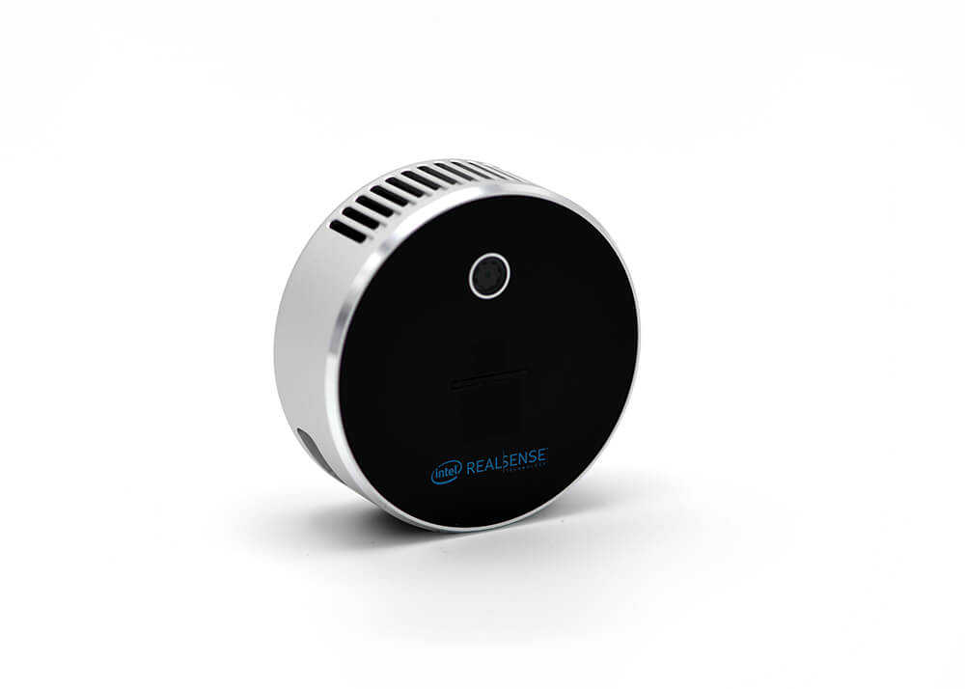
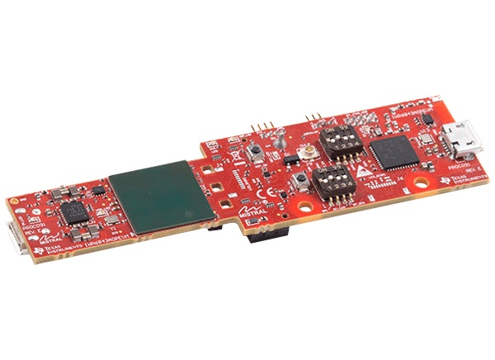
Electronics Assembly
5 V
GND
I2C
3.3 V
Mounted on servo
with ¼-20 UNC thread
Human and cluster recognition and distance tracking algorithms
libi2c for servo control
120º pan mechanism
Introduction
Mechanical Assembly
Depth Camera
Electronics Assembly
BOM
mmWave Sensor
Sensor Comparison

Slide 8
BOM
Source | Item | Description/Comment | Qty | Currency | Unit Cost | SGD Cost | TOTAL | Est. lead time (days) | Status
Digi-key | Intel RealSense LiDAR Camera L515 | Camera: 1920 x 1080; 60 fps Depth Accuracy: ~5 mm to ~14 mm thru 9 m 2D Field of View (FOV): 70° × 55° (±3°) Depth Camera: Up to 1024 × 768; 30 fps | 1 | USD | $393.75 | $532.89 | $532.89 | 5 | Delivered
Texas Instruments | IWR6843AOP mmWave sensor | Operating frequency: 60-GHz to 64-GHz Antennas: 4 receive (RX) 3 transmit (TX) antenna FOV: 120° azimuth and 120° elevation | 1 | USD | $141.24 | $191.15 | $191.15 | 5 | Delivered
Huei Ming | NVIDIA Jetson Nano Developer Kit | Memory: 4GB Power requirement: 5V Model: B01 | 1 | SGD | $169.00 | $169.00 | $169.00 | 4 – 6 | Given
 | MicroSD Card | Capacity: 64 GB | 1 | SGD | $3.99 | $3.99 | $3.99 | NA | Given
Note: items in blue are not directly deducted from the SGD500 budget |  |  |  |  |  | SUBTOTAL | $893.04
Unicell | Power Supply for Jetson Nano | Output: 5V 5A 25W Output terminal type: PC04 DC plug (5.5 x 2.5 mm) | 1 | SGD | $36.84 | $36.84 | $36.84 | NA | Collected
blueidea (Lazada) | Servo Mount Brackets | DOF: 2 (pan and tilt) Compatible: 40mm × 20mm × 36mm servo motors | 1 | SGD | $6.80 | $6.80 | $6.80 | 5 – 13 | Delivered
 | Shipping | China |  | SGD |  | $1.49
Open-source (Lazada) | Servo Control Board | Number of channels: 16 Resolution: 12 bit Voltage: DC 5 -10V | 1 | SGD | $5.54 | $5.54 | $5.54 | 5 – 13 | Shipped
 | Shipping | China |  | SGD |  | $1.49 | $1.49
luckcute.sg (Shopee) | Servo Motor | Dimension: 40mm x 19mm x 43mm Net weight: 69g Operation Voltage: 4.8 - 7.2 Volts | 2 | SGD | $3.90 | $3.90 | $7.80 | 7 – 14 | Shipped
 | Shipping | China |  | SGD |  | $1.00 | $1.00
 |  |  |  |  | SUBTOTAL | SUBTOTAL | $64.95
 |  |  |  |  | GRAND TOTAL | GRAND TOTAL | $957.99
Introduction
Mechanical Assembly
Depth Camera
Electronics Assembly
BOM
mmWave Sensor
Sensor Comparison

Slide 9
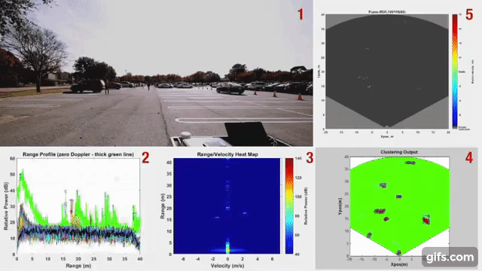
mmWave Sensor (clusters further in range)
Capabilities:
60GHz
Detects human up to 60m
120° field of vision (azimuth and elevation)
Angular resolution (azimuth and elevation): 29°
Introduction
Mechanical Assembly
Depth Camera
Electronics Assembly
BOM
mmWave Sensor
Sensor Comparison
Notes:
High frequency and short wavelength gives high accuracy
Angular resolution is how far two objects must be to differentiate

Slide 10
mmWave Sensor Software
mmWave SDK
mmWave industrial toolbox
Code Composer Studio (IDE)
Uniflash (to flash the iwr6843AOPEVM)
Introduction
Mechanical Assembly
Depth Camera
Electronics Assembly
BOM
mmWave Sensor
Sensor Comparison

Slide 11
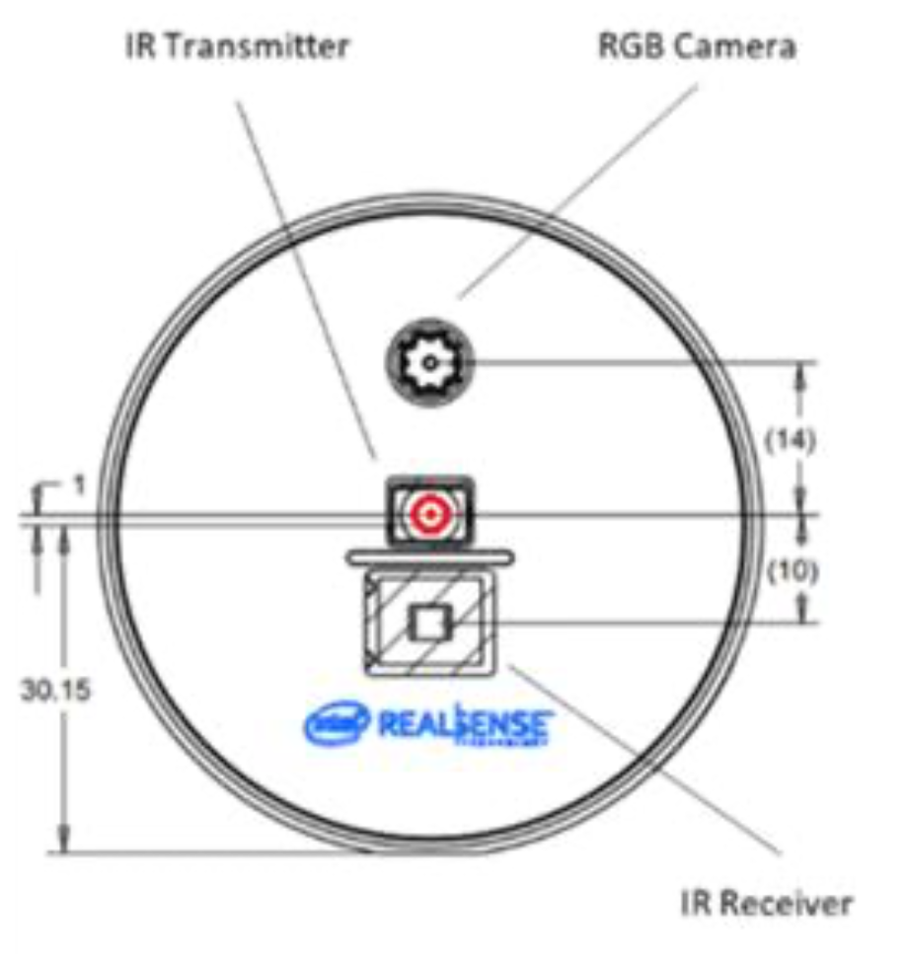
Intel RealSense L515 (inter and intra cluster information)
Depth range: 25 cm to 9 m
2 MP RGB Camera
Depth FOV (field of view): (H × V) 70°±2° x 55°±2°
Depth frame rate: 30 frames per second
RGB frame rate: 30 frames per second
Power consumption: < 3.5W
IR wavelength: 860 nm
Introduction
Mechanical Assembly
Depth Camera
Electronics Assembly
BOM
mmWave Sensor
Sensor Comparison

Slide 12
Intel RealSense L515 Software
Intel Realsense SDK 2.0
Cross-platform library for Intel RealSense depth cameras
Introduction
Mechanical Assembly
Depth Camera
Electronics Assembly
BOM
mmWave Sensor
Sensor Comparison

Slide 13
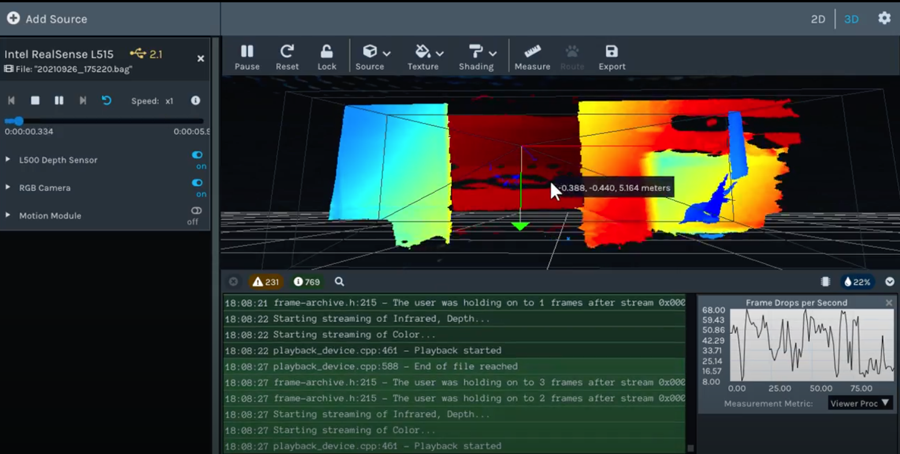
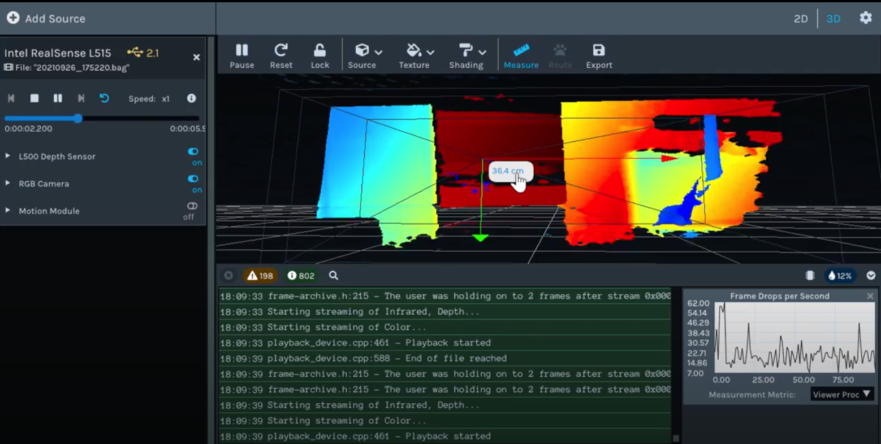
Introduction
Mechanical Assembly
Depth Camera
Electronics Assembly
BOM
mmWave Sensor
Sensor Comparison

Slide 14
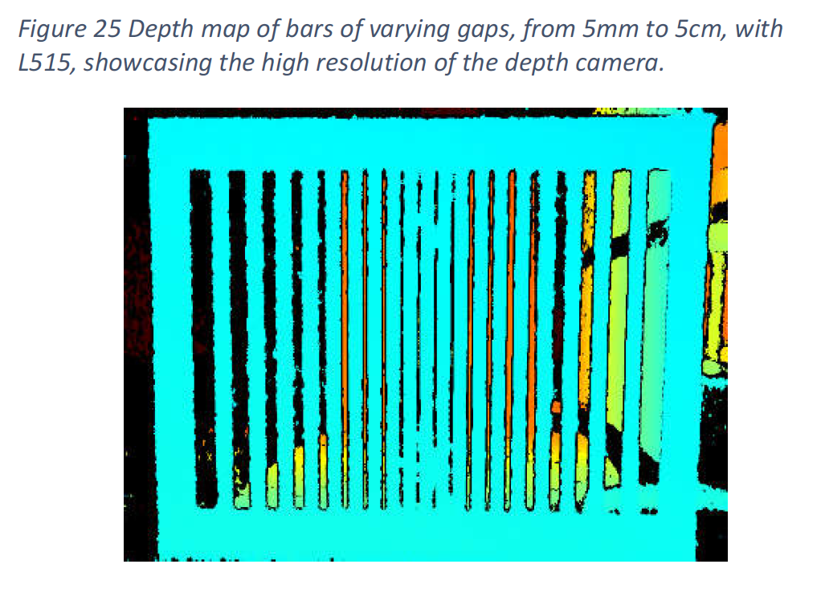
Sensor comparison
3D Camera (LiDAR) | 3D Camera (stereoscopic) | mmWave Radar | Sonar | Infrared
High accuracy and edge resolution with decent range | Lower accuracy, edge resolution and range compared with LiDAR | High accuracy and range but low object resolution | Low accuracy, range and response time | Lower accuracy and range
Fast update rate; suitable for fast-moving objects |  | High sampling rate | Low resolution and slow update rate, making it not suitable for detection of fast-moving targets
Introduction
Mechanical Assembly
Depth Camera
Electronics Assembly
BOM
mmWave Sensor
Sensor Comparison

Slide 15
Thank You!

Slide 16
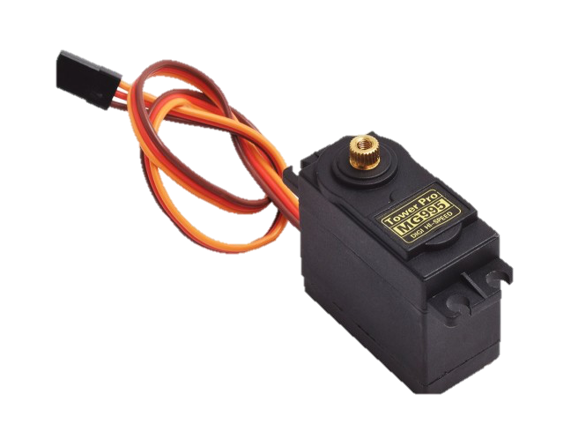
5 V 2 A
GND
SCL
SDA
3.3 V
5 V 2 A

